Slide 1
Orlando
Mark Marji
GEO109 Final Project
Spring 2021

Slide 2
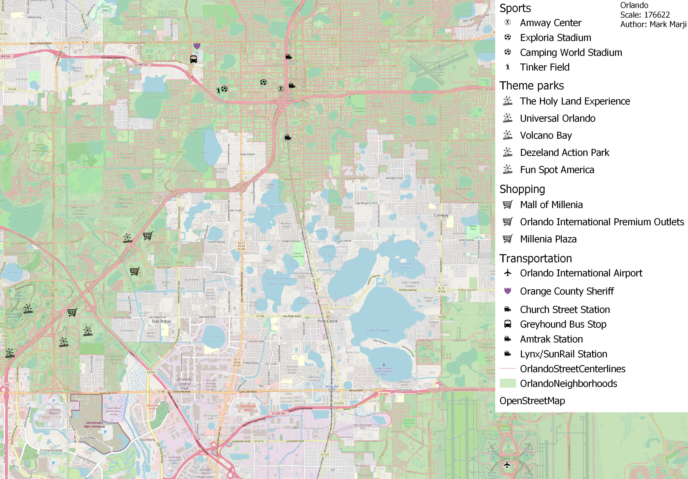
Map

Slide 3
Introduction
The audience for my map are tourists and anyone who is interested in visiting the attractions that are located in Orlando, Florida. My intent for this map is to tell people what the tourist attractions in Orlando are, and to provide a guide for them to visit the city. I chose to create this map because I was interested in creating a map of a city that was located in Florida, and Orlando was the most interesting city I have picked. Orlando has available Open Data GIS, which is another reason why I picked this map.

Slide 4
Data and Mapping
I have used data from the Orlando website (Orlando.gov) to find open data for my map. I have selected this website because it offered open data I could use for my project. The first process I used to create the map was to download a GIS for the landmarks, streets, and neighborhoods in the city. Afterwards, I used the OpenStreetMap feature to make the setting look like a realistic map, and this was done by clicking on the XYZ files and dragging the map to the “layers” tab. I also used the “filter” tool to filter out areas of the map. For example, I used the “filter” tool to include the address of Universal Orlando. I also used Microsoft Excel to get the latitude and longitude for the Orlando International Airport.

Slide 5
Aesthetics and Design
The balance includes a horizontal (X, Y) dimension and the use of latitude and longitude to insert the Orlando International Airport. I use different sizes for the map ranging from 4.000 to 10.000.
The map includes different symbols. For the Orlando International Airport, I used a airport symbol. For theme parks like Universal Orlando, I included the waterwheel symbol because it resembles a ferris wheel. I also used transportation symbols such as the police badge for the police station and train symbols for train stations (Ex: Amtrak Station).
I accessed the police badge icon by clicking on the “Symbology” tab and clicking on a folder called “emergency”. Afterwards, I selected the police badge icon.
I would improve the design of this map by finding more attractions that are located in Orlando and using Microsoft Excel to create their latitude and longitude. I would also include museums in the map as well as the use of the “museum” icon, which is found in the “symbology” tab.

Slide 6
Aesthetics and Design
These two screenshots are examples of how I used symbology for the icons.

Slide 7
Interpretation and Discussion
In this project, I learned how to use the “filter” tool to filter stuff such as the address and types of objects. I filtered the address for attractions by going to the attribute table to find the address, as well as typing the address and using the “filter” tool. I also was able to use the “filter” tool to address the clustering, which was shown in the Universal Orlando section, and this was done by keeping the Universal Orlando attribute. The Islands of Adventure icon was removed after I went to the “filter” tool to type the address for Universal Orlando.
I also learned how to group objects. For example, the points containing the theme parks are in a group called “theme parks”.
I stated that my audience would be tourists and anyone who is interested in visiting Orlando. This map addresses the audience because it lists tourist attractions that they are interested in visiting such as theme parks, sports venues, and shopping areas.
The strengths of my project is the use of different symbols to represent the types of tourist attractions and learning how to use the OpenStreetMap feature. The weaknesses of my project is that I should add more stuff such as attractions. Another weakness is that there are several empty spots that I think could a landmark or two.
If there is anything I could do to improve this project, I would add more attractions to the project. This includes the Orlando Eye and the upcoming Epic Universe park.

Slide 8
References
“GIS Data Download.” City of Orlando. Accessed April 30, 2021. https://www.orlando.gov/Our-Government/Records-and-Documents/Map-Library/GIS-Data-Download.
“Orlando International Airport Latitude and Longitude.” Distancesto.com. Accessed April 30, 2021. https://www.distancesto.com/coordinates/us/orlando-international-airport-latitude-longitude/history/167.html.
“Millenia Plaza.” Google Maps. Google. Accessed April 30, 2021. https://www.google.com/maps/place/Millenia+Plaza/@28.4952339,-81.4312693,17z/data=!3m1!4b1!4m5!3m4!1s0x88e77eaad33b9463:0x577fcbd74d1d7691!8m2!3d28.4952339!4d-81.4290806.

